Slide 1
MOSIP - Sprint 6 Demo Dec 17th , 2018

Slide 2
Pre Registration
MOS-814
As an Individual, I should be able to search Registration center :UI
MOS-797
As an Individual, I should be able to update a Pre-Registration: UI
MOS-818
As an Individual, I should be able to cancel an appointment :UI
MOS-978
As an Individual, I should be able to reschedule a booked appointment, so that I can choose the preferred time slot: UI
MOS-817
As an Individual, I should be able to choose an available time slot and book an appointment: UI

Slide 3
Pre Registration
MOS-664
As an Individual, I should be able to choose an available time slot and book an appointment
MOS-816
As an Individual, I should be able to choose the Registration center from the result list, and get the availability slots for the chosen day: UI
MOS-665
As an Individual, I should be able to cancel an appointment
MOS-1891
As MOSIP system, I should support Batch Job configuration for Pre-Registration.
MOS-977
As an Individual, I should be able to reschedule a booked appointment, so that I can chose the preferred time slot
MOS-663
As an Individual, I should be able to choose the Registration center from the result list, and get the availability slots for the chosen day.

Slide 4
Registration Client
MOS-1200/1223
API/UI:As a Registration Officer/MOSIP system, I should be able to download pre-registration data to the client system manually
MOS-1277/1367
API/UI:As a Registration Officer/MOSIP system, I should be able to download pre-registration data in real time for a specific PRID
MOS-1343
UI:As the MOSIP Registration Client, I should be able to encrypt and decrypt pre-registration packets received from the data store
MOS-1235
UI:As the MOSIP Registration Client, I should be able to sync master data with data store servers
MOS-1244
UI:As a MOSIP registration client, I should be able to sync Policies with data store servers.

Slide 5
Registration Client(continued)
MOS-10406
API:As the MOSIP registration Client, I should enable defaulting date of birth if only age is given
MOS-1214/1290
API/UI:As the MOSIP Registration Client /MOSIP system, I should enable scan and upload of POI, POA and POR
MOS-1342
UI: As a registration officer, I should be able to capture an individual's finger prints as per specification
MOS-1300
API:As the MOSIP Registration Client, I should perform a local duplicate check for biometrics data of an individual against the mapped registration officers' biometrics
MOS-1285
UI: As a Registration Officer, I should be able to capture an individual's IRISes as per specification

Slide 6
Registration Client(continued)
MOS-1301
API:As the MOSIP Registration System, I should enable Registration Officer to authenticate each registration with password/biometrics/multi factor elements
MOS-1307/1310
API/UI:As the MOSIP Registration Client/MOSIP system, I should enable the supervisor to authenticate registration in case of exceptions
MOS-1273/1278
API/UI: As the MOSIP Registration Client/MOSIP system, I should enable receiving a unique registration ID on completion of registration

Slide 7
ID-Authentication
MOS-1149
As the MOSIP system, I should be able to evaluate the Individual's Fingerprint match with the corresponding Fingerprint in the Auth server
MOS-1146
As the MOSIP system, I should be able to authenticate the Fingerprint of the Individual by comparing the match score of the fingerprint against threshold
MOS-10165
Integrate Fingerprint Authentication with eKYC

Slide 8
Registration Processor
MOS-240
As the MOSIP System, I should be able to validate the Registration Machine Details, Registration Officer Details and Registration Center Details
MOS-1059
As the MOSIP system, I should be able to Verify the Biometrics against the UIN of a Parent
MOS-48
As the MOSIP system, I should be able to Verify the Documents required for an Individual based on the Type of Registration
MOS-1079
As the MOSIP system, I should be able to Perform Demo dedupe - Part 1
MOS-1064
As the MOSIP system, I should be able to Perform Demo dedupe - Part 2

Slide 9
Registration Processor (contd..)
MOS-1076
As the MOSIP System, I should be able to identify packets on hold, so that it can be allocated for Manual Verification
MOS-1077
As a Manual Verifier, I should be able to view a packet detail lined up for manual verification
MOS-1078
As a Manual Verifier, I should have an option to change the status of a packet kept on hold
MOS-9657
Implementing RID Validator

Slide 10
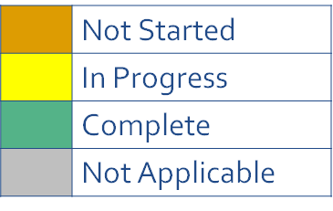
Testing Journey so far….. Till Sprint6
Covered Testing Activities:
Mind-Map creation
Test scenario identification
Test Data readiness - Data generator using Test Data Utility
Test scripts & Test Cases
Test Framework
QA Environment & Test Rig
Defect Validation (Jira)
Testing Artifacts Repository/Reference:
Github
Jira
Zephyr for Test Cases – Work in progress….
Activities Complete
QA environment setup
MindMap creation
Test scenario identification
Test Data readiness - Data generator
Test scripts
Test Framework
Test Rig
Defect (Jira)

Slide 11
Testing Key highlights – Sprint6
Covered the Backlog of SprintFIT1 and Sprint5 – Mindmap and Test Case Design.
FIT2 sprint grooming covering E22 and Integration Scenarios
Sprint6 - Mindmap and Test Case Design.
Functional
Automation for Sprint5 and FIT1 backlogs
Bug fix validation for Sprint4 user stories
FIT2 Grooming- Identification of integration scenarios
TestNG design approach on triggering SOAPUI scripts
POC on modular approach on API automation
API Automation
Test Data Utility
Test Data utility to generate versatile input data – covering Test data for UI fields & API
Performance
Performance Load for API’s w.r.t each module(s)

Slide 12
API Automation Coverage
Module | TCs Automated | Defects Count | Not Automatable | API’s Covered
Kernel | 170 | 28 | 20 | Master Data Manager
Pre-Registration | 40 | 17 | 8 | Create Pre-Registration, Fetch all Applications, Retrieve all Pre-Registrations status, Discard Pre-Registration, Upload Document, Fetch Pre-Registration, documents
IDA | 134 | 15 | 15 | /identity/otp /identity/auth /identity/getOTP /ekyc
TOTAL | 344 | 60 | 43

Slide 13
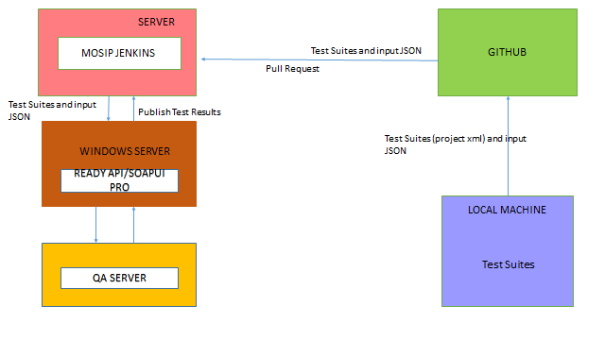
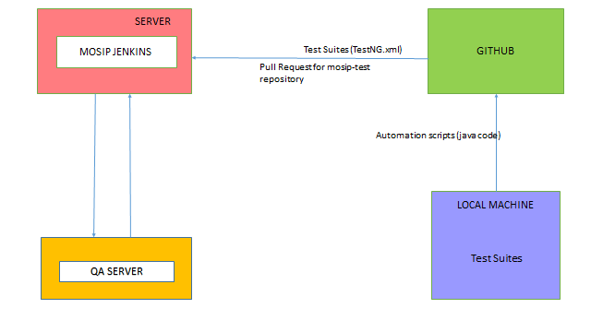
Enhanced Test Rig
Existing Test Rig
Enhanced Test Rig

Slide 14


Test Data Utility for Rest APIs
Configuration property file
Test Data Utility Jar
Mater yml file (Data Dictionary) with all the valid and invalid data for all Rest API fields

Slide 15
Performance Updates
Released SPRINT | Module | JIRA User Story(PT) | API | PT Script | PT Script Execution | PT Report
Sprint 5 | Kernel | MOS-10571 | UIN Generator | Done | Done | Done
Sprint 5 | Kernel | MOS-10571 | Audit Manger | Done | Done | Done
Sprint 5 | Kernel | MOS-10571 | Packet Uploader | Done | Done | Done
Sprint 5 | Kernel | MOS-10571 | Generate OTP | Done | Done | Done
Sprint 5 | Kernel | MOS-10571 | Validate OTP | Done | Done | Done
Sprint 5 | IDA | MOS-10570 | Authentication-personal identity | Done | Done | Done
Sprint 5 | IDA | MOS-10570 | Generate OTP | Done | Done | Done
Sprint 5 | IDA | MOS-10570 | Authenticate-OTP | Done | Done | Done
Sprint 5 | Reg-Processor | MOS-10572 | Sync registration data | Done | Done | Done
Sprint 5 | Reg-Processor | MOS-10572 | Upload registration packet | Done | Done | Done
Sprint 5 | Reg-Processor | MOS-10572 | Registration status | Done | Done | Done

Slide 16
Defects Status
Priority | Done - Status | In Progress - Status | To Do - Status
High | 26 | 3 | 18
Highest | 5 | 0 | 3
Medium | 24 | 11 | 26
Grand Total | 55 | 14 | 47

Slide 17
THANK YOU

